Slide 1
CS Club Second Meeting
9-24-20

Slide 2


Agenda
HTML & CSS!

Slide 3
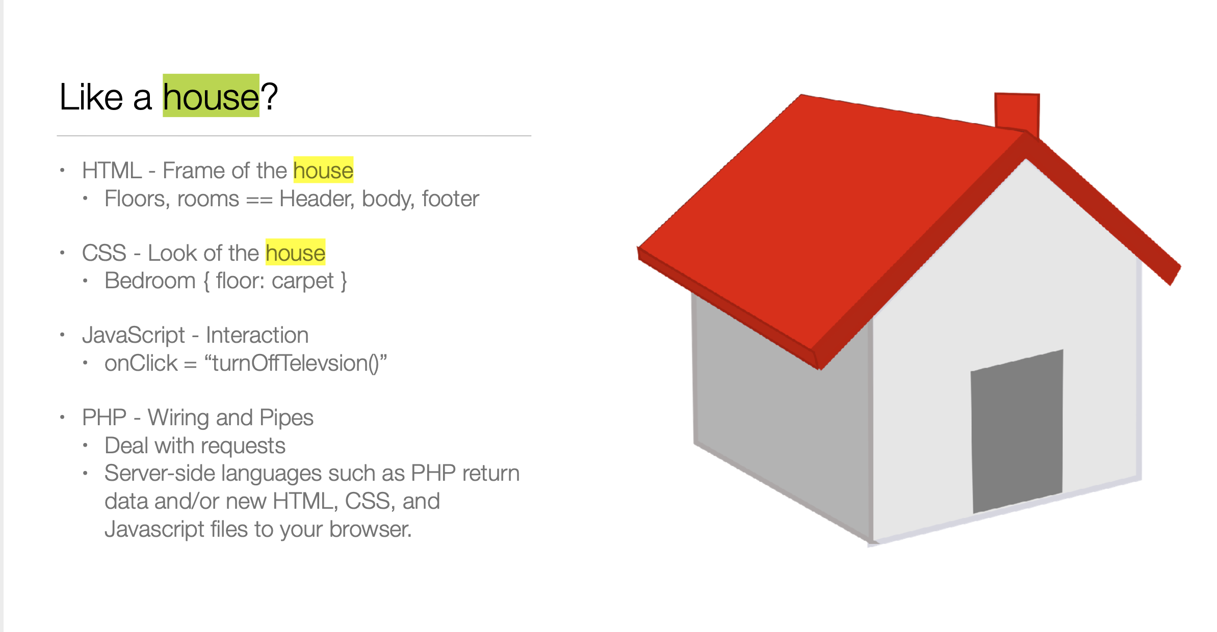

Slide 4
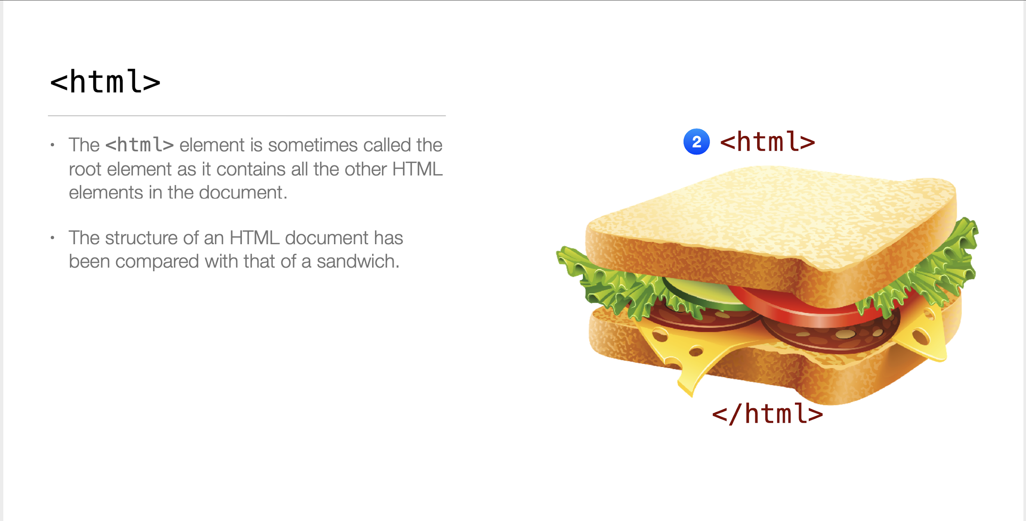

Slide 5
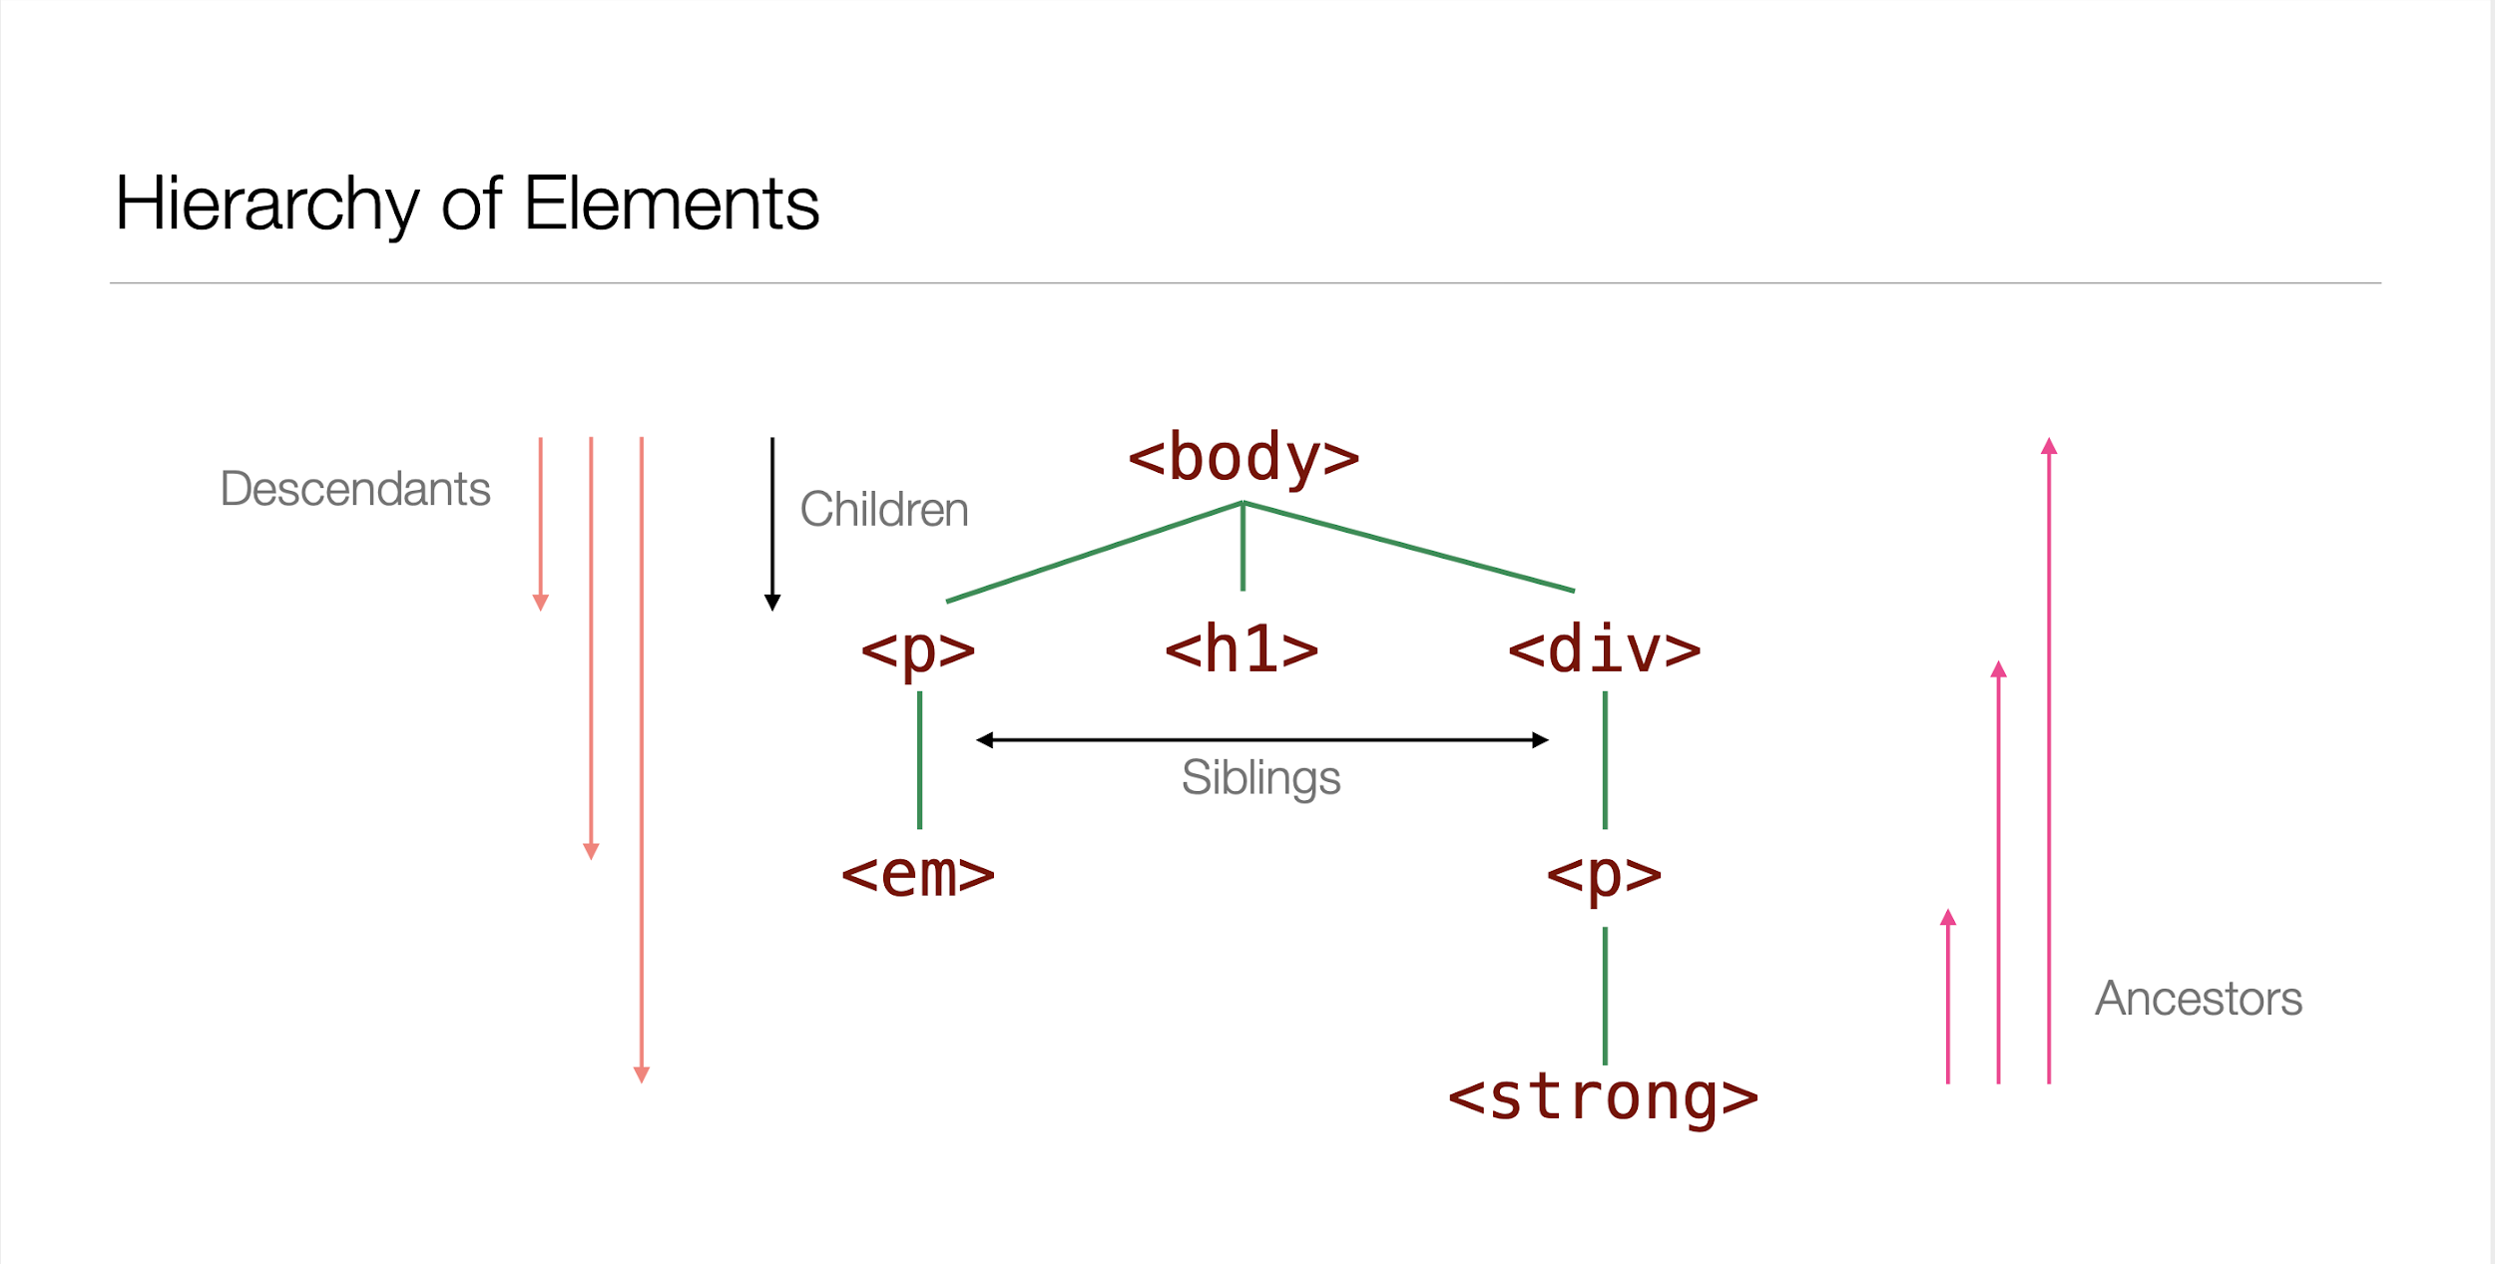

Slide 6
What goes on in the <head> </head> tag?
Link other files:
CSS - cascading style sheet
JS - javascript
Specify the encoding of the page
Usually utf-8
Provide the title
This is what you see listed on the physical tab on most browsers

Slide 7
What about the <body> </body> tag?
Everything you see on your browser is in some way defined in the body tag.
Even dynamic websites with moving objects are updating the DOM or drawing on the html canvas tag (what is located in the body).
What is the DOM:
DOM stands for Document Object Model
It is a tree structure that describes the current hierarchy of the webpage you are on.
Javascript has the ability to make changes to the DOM when the mouse is moved or a button is clicked.

Slide 8
What kind of tags are at my disposal?
Heading tags (h1 - h6)
The header tag
<header> </header>
The paragraph tag
<p> </p>
<div> </div> (perhaps the most important)
Ordered and unordered lists
<ol> </ol>
<ul> </ul>
Table - there’s quite a bit that goes into this one.
<table> </table>
The footer tag
<footer> </footer>
Link tag (for linking other pages)
<a> </a>
Images
<figure> <img/> </figure>
A bunch more!

Slide 9
We can only do so much with html
Black and white text
Some bulleted/numbered lists
Plain tables
An image or two
Pretty Boring!!

Slide 10
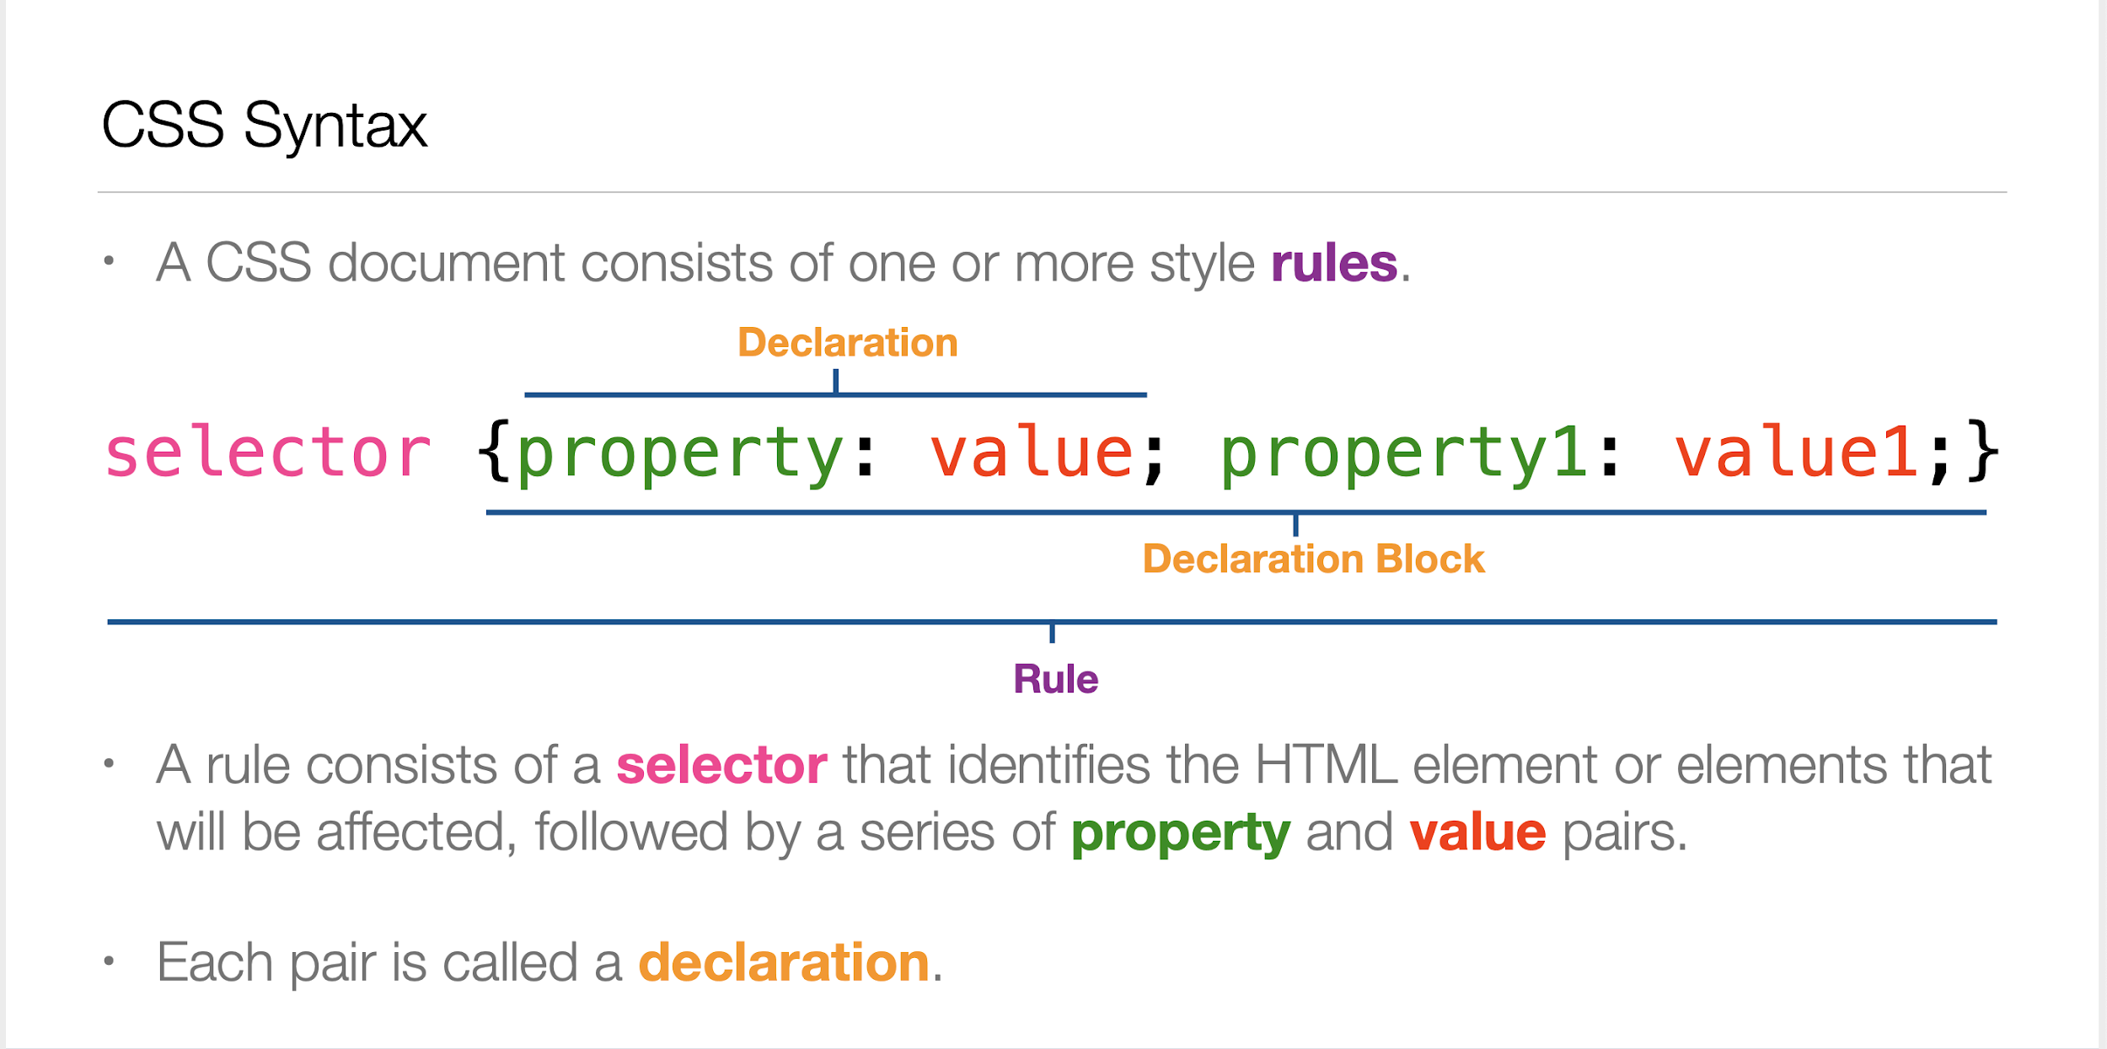

Slide 11
Remember I said <div> is important
With CSS we can use div tags to style everything in a certain group
#about_me p {color: green; }
The above code sets the font color to green in any paragraph tag located inside of a div tag with id - “about me”

